Slide 2
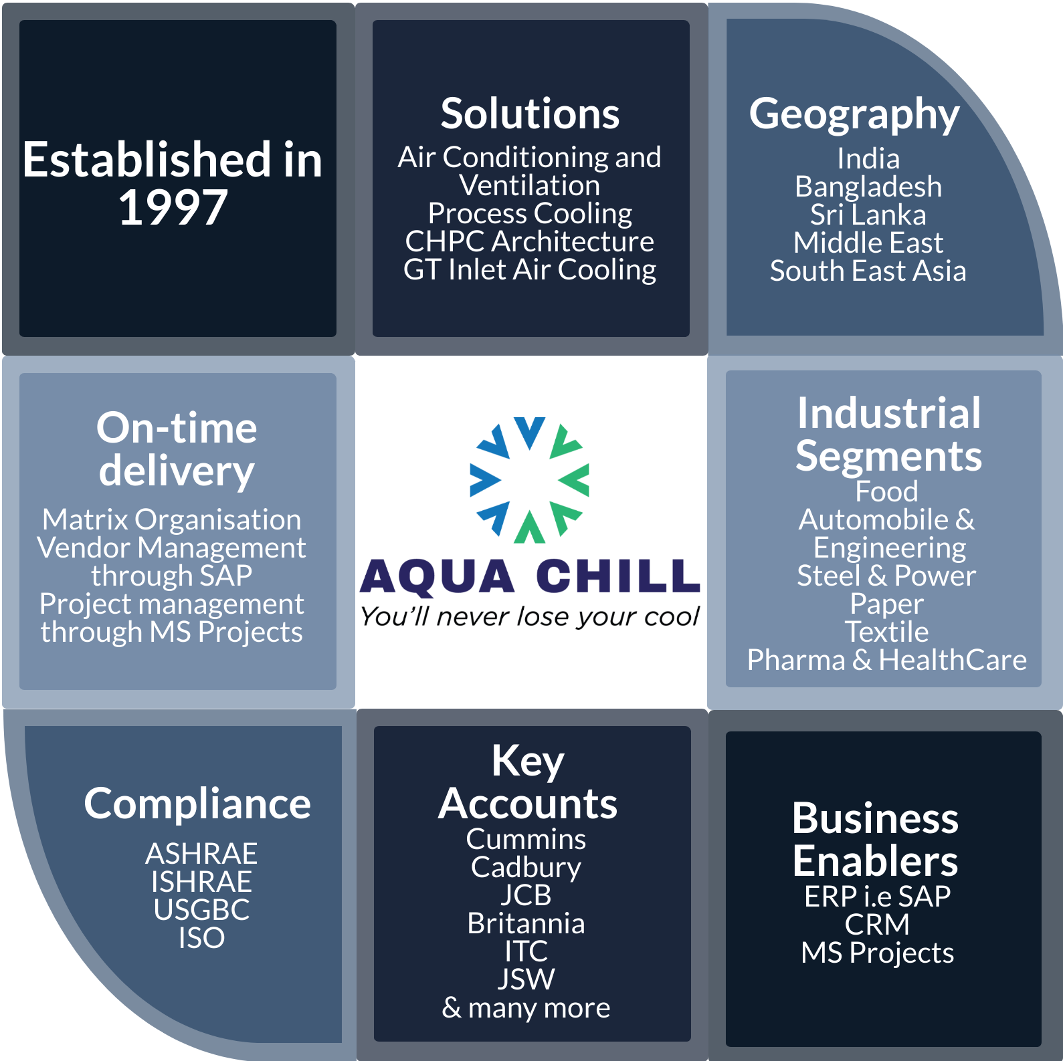

Slide 4
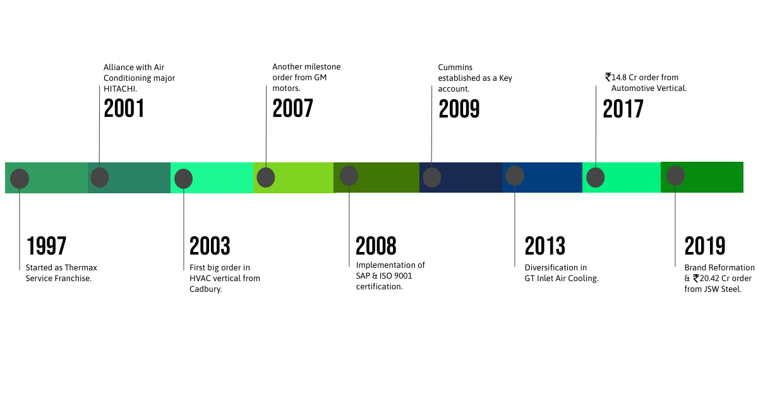
Timeline/Itinerary

Slide 5
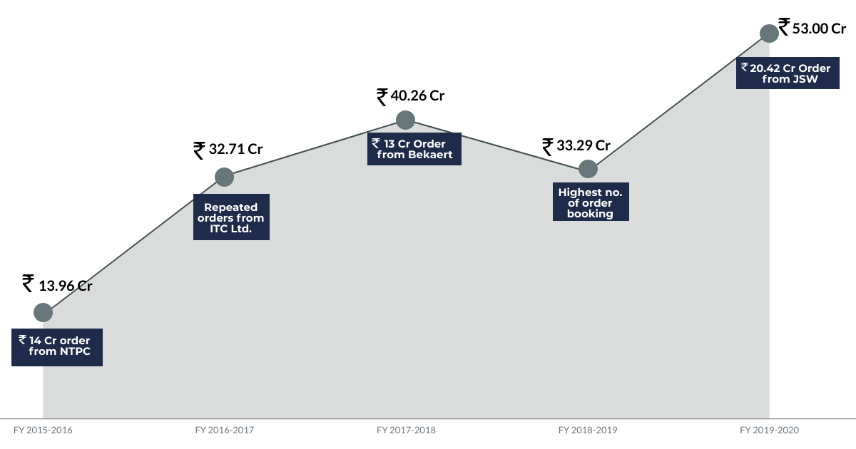
Revenue from FY15-FY19

Slide 6
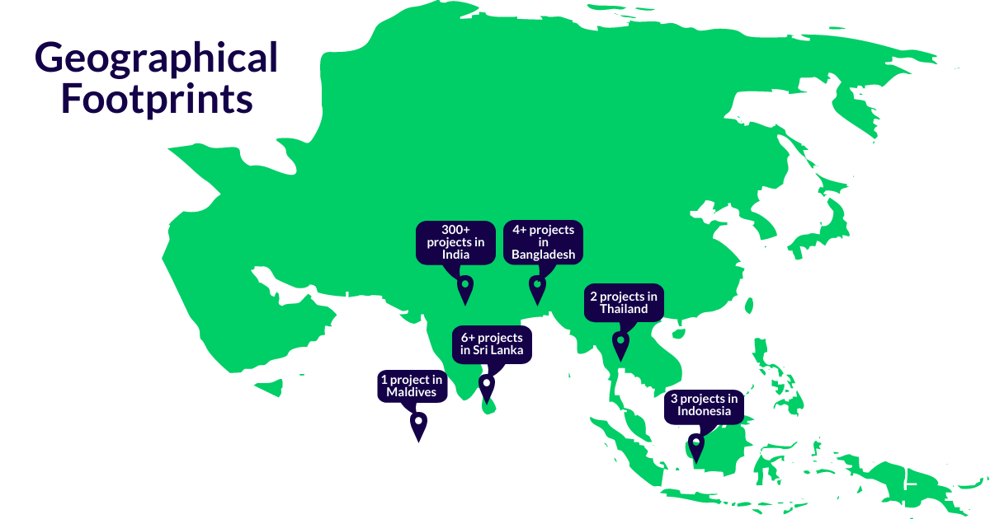

Slide 7
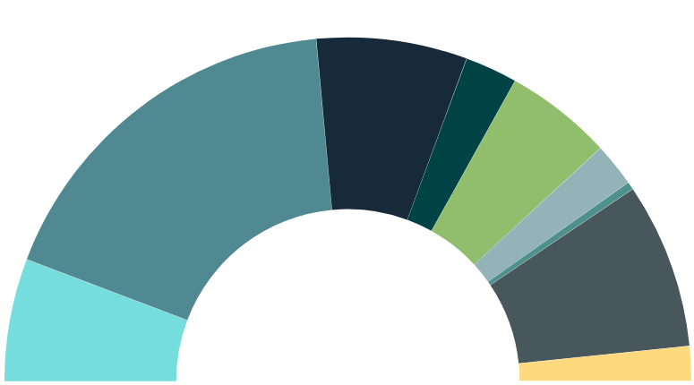
TR Delivered
Eng. & Auto:
7.2K TR
Paper:
2.5K TR
Steel & Power: 17.6K TR
Chemical:
5.1K TR
Healthcare: 2.1K TR
Pharma: 0.4K TR
Textile:
7.7K TR
F & B:
5.7K TR
Others:
1.7K TR
Notes:
Number Notation in Thousands

Slide 8
CFM Delivered
Eng. & Auto:
4000K CFM
Paper:
70K CFM
Chemical:
1020K CFM
Steel & Power: 600K CFM
Pharma: 100K CFM
Textile: 200K CFM
F & B:
600K CFM
Others:
445K CFM
Notes:
Number Notation in Thousands

Slide 9
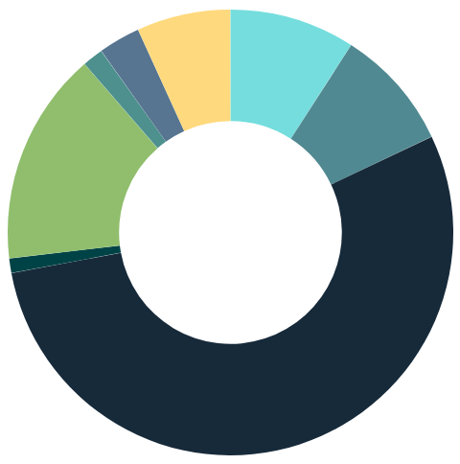
Ducting Work Done(sq. ft.)
Textile: 19.2K
Others:
42K
F & B:
55K
Pharma: 9.2K
Steel & Power: 54K
Chemical:
94K
Paper:
6.4K
Eng. & Auto:
330K
Notes:
Number Notation in Thousands

Slide 10
-Customer Base-

Slide 11
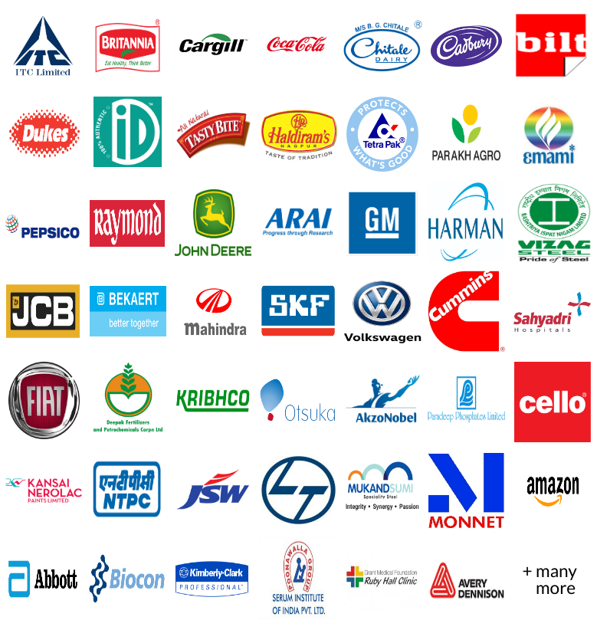
OUR CUSTOMERS

Slide 12
KEY ACCOUNTS
Our Customer Keep Coming Back to Us for Their New Requirements Due To Our Quality, Safety Records, On-Time Delivery and Unmatched Performance
40% Repeat Orders
Show Confidence
Trust of Our Customer in Us

Slide 13
DOMESTIC RFERENCE LIST
Sr. No. | Client | Project Name | Scope of Work
1 | JSW Steel Ltd. | HVAC System for PP3 Plant | Water Cool Screw Chillers, Cooling Tower, Chilled Water Pumps, Piping, Insulation, AHU, Ducting, ADS Component, Valves, MCC & Electricals, Controls & Instrumentation
2 | John Deer | HVAC Package for 5M Project | 2 Stage Evaporating Cooling Units, HVLS Fans, Powder Coated Ducting, ADS Components, Piping, Insulation, MCC Panel, PLC & Control
3 | Mars International India Pvt Ltd. | HVAC System For MANI Project | AHU, Chilled Water Piping Insulation, Valves & Instrument, Ducting with Insulation, ADS Component, MCC & Electrical
4 | Bekaert | Ventilation Project at ISC | 2 Stage Evaporating Cooling Units, HVLS Fans, Powder Coated Ducting, ADS Components, Piping, Insulation, MCC Panel, PLC & Control
5 | Cadbury (Mondelez India Ltd.) | HVAC System for Bournvita Production Plant | Water Cool Screw Chillers, Cooling Tower, Chilled Water Pumps, Piping, Insulation, AHU, Fabric Ducting, ADS Component, Valves, MCC & Electricals, Controls & Instrumentation
6 | Kimberley Clark | HVAC System for New Production Line | Cooling Tower, Chilled Water Pumps, Condenser Water Pumps, Chilled Water Piping, Insulation, Valves & Instruments, Hot Well & Cold Well Tanks
7 | Cummins | Air-Conditioning Work at CFSI | Air-Cooled Chillers, HVLS Fans, Pumps, AHU, Chilled Water Piping, Insulation, Valves & Instrumentation
8 | ITC Ltd. | Project for Paper & Pulp Plant | Water Cooled Chillers, AHU, Pumps, Chilled Water Piping, Fan Coil Unit, Heat Exchangers, Precision Air-Conditioning, Valves & Instrumentation

Slide 14
INTERNATIONAL REFERENCE LIST
Sr. No. | Country | Client | Scope of Work | TR
1 | Bangladesh | Abul Khair Steel, Chittagong | Supply of CHPC System including Absorption Chiller, Cooling Tower, Condensor & Chilled Water Pumps, Expansion Tank, Piping, Valves and Instruments, AHU & FCU Piping, Ducting, Insulation, ADS Components, MCC Panels, Cabling and Accessories. Sup. Of E&C | 500
2 | Bangladesh | Tamishna Synthetic | Supply of Fan Coil Units | 250
3 | Taiwan | OTPC, Taiwan | Inlet Air Cooling System for Process Air Compressor in Urea Plant | 750
4 | Maldives | Anantara Resort | SITC Complete CHPC System and Comfort Air-Conditioning | 300
5 | Kenya | Busia Sugar Industries | Ductable Units, Piping, Ducting, Insulation, ADS Components, MCC, Tools and tackles, Spares, Drawings Ductable Units, Piping, Ducting, Insulation, ADS Components, MCC, Tools and tackles, Spares, Drawings | 150
6 | Indonesia | Dynaplast – Kaltimex | Heat Exchanger, Pumps, Pipes, Control Panel, Insulation, Valves, Instruments, | 100
7 | Indonesia | Wilmar Industries, Surabaya | SCADA control room Air-Conditioning for Edible Oil plant | 150
8 | Thailand | E-3 Asia Design | Design & Engineering Consultancy | -

Slide 15
Thanks for your audience!!

